Slide 1
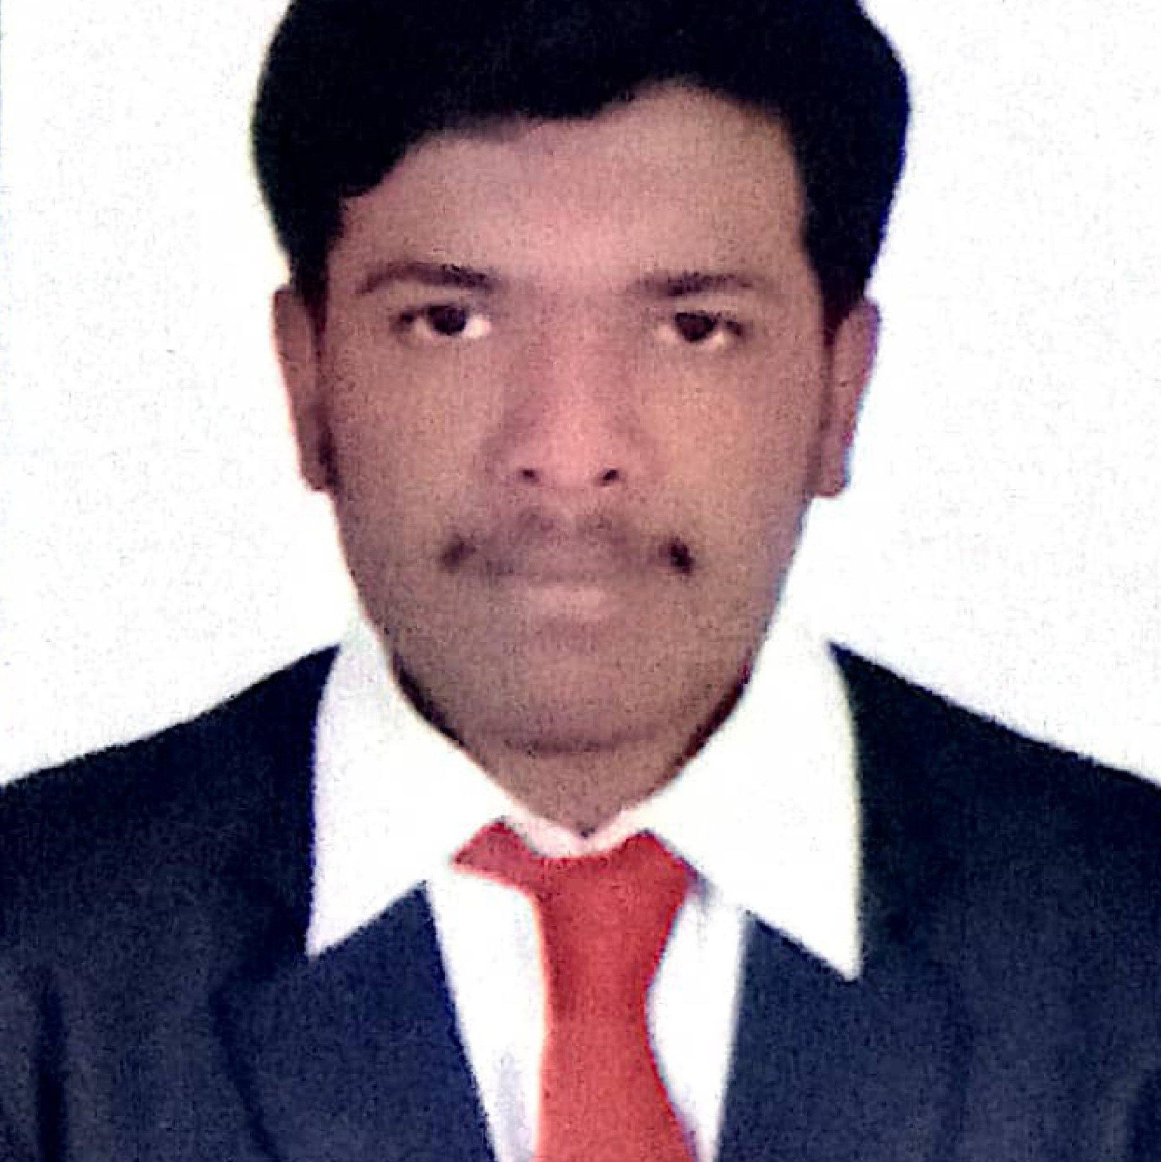


Charan R
Analyst/Software Engineer
Master of Computer
Application :2019-2021
Skills Java 8
Spring Boot
Spring MVC
ReactJS
Database
SQL database
PostgreSql database
Web Technologies
HTML5
CSS3
Javascript
AddOns
Github
Maven
Postman
Additional skills
Leadership Qualities
Quick Learner
Team Management
BANGALORE
Charan.c.r@CAPGEMINI.COM
+91 9900824370
A4
Eager to work in a team of dedicated people and serve a key role in the enhancement and development of the project.
Software Engineer who is Strong in design and integration with intuitive problem-solving skills. Passionate about implementing and launching new projects.
Ready to learn new technologies and implement them to further improve my knowledge.
Has working knowledge on React and Java Microservice Development using Spring framework on an intermediate level.
Sweet shop management system :
Completed end to end case study of Online Sweet shop management system(product and offer) along with JWT authentication, Swagger and payment testing. Material-UI and React used for user interface.
HTML CSS JAVASCRIPT for web developers at DEGREED
Completed this course with 95% and Designed responsive Sweet shop website using HTML5 CSS3
React js
https://github.com/ByteHackers

